Slide 1



IMAT 2704: Literature Review
Beverley Hancock-Smith Centre for Learning and Study Support (CLaSS) Enhancing academic practice, writing development and professional skills

Slide 2

In this session we will look at...
What is a literature review?
Drawing out themes
Structuring a literature review
Synthesising sources

Slide 3
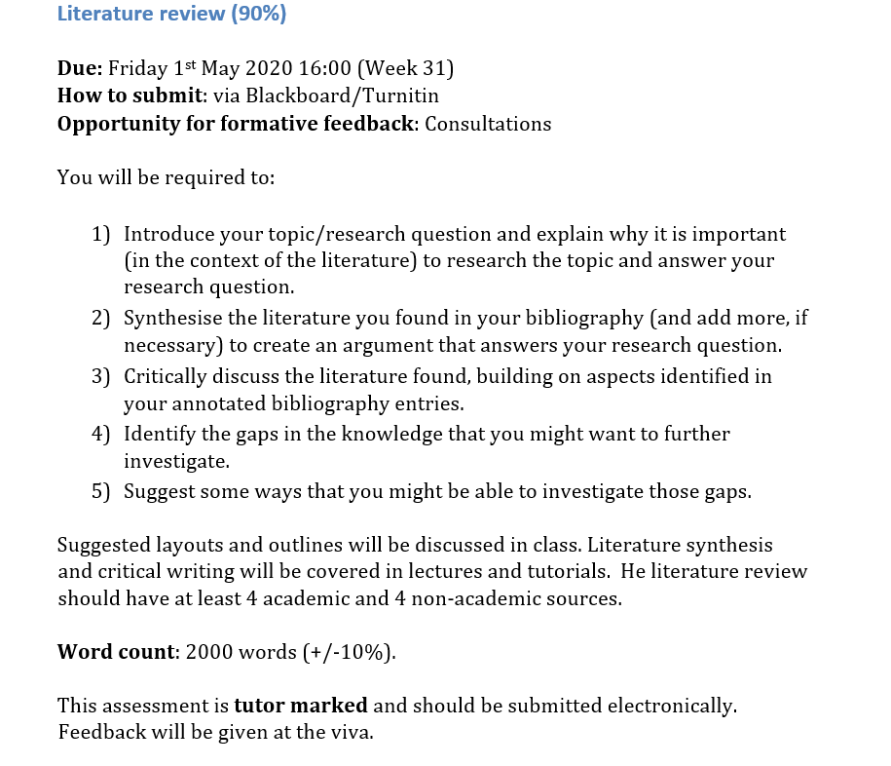
Your assignment

Slide 4

Your thoughts
What are your concerns about carrying out a literature review?
Use your smartphone to navigate to the web address opposite

Slide 5

Literature Review What is it?

Slide 6
Literature review
It is used to Frame your own research and to show the reader that you …
understand what has already been done on your topic
understand how it has been researched
recognise the key issues
are familiar with different points of view
can integrate all the information in a coherent and organised way.
“The comprehensive study and interpretation of literature that relates to a particular topic”
(Aveyard, 2010, p.5)

Slide 7
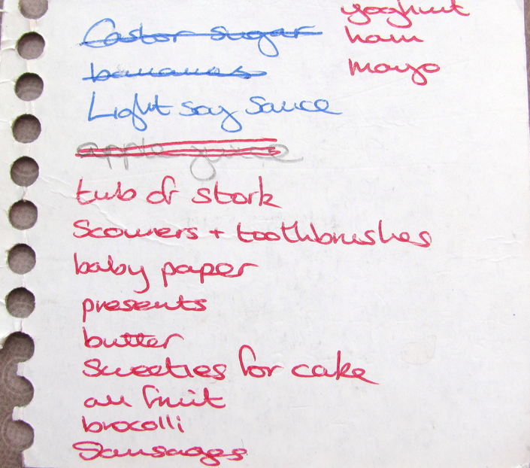
What a literature review is not…
Notes:
Bev

Slide 8
A good literature review includes:
Description
(kept to a minimum)
Analysis and evaluation
(ask questions about the reliability of claims; provide your own interpretations)
Synthesis
(group similar points together; highlight and explain similarities and differences between sources)

Slide 9
Critical reading steps
Identify the main argument and relevance to your research question
Skim through key sections to identify research findings
Evaluate key sections and the research as a whole
Note down a synthesis of your observations
(Adapted from Zahora 2013)

Slide 10

Drawing out themes

Slide 11

Activity 1: Having clear Goals
What are your main two or three objectives for your literature review? Write them down.
Objectives = things you need to do to meet your aim(s)
Be specific about your activities, key words, etc.
If you finish early, compare with a neighbour – is it clear how you could do this? How could it be made clearer?

Slide 12

Activity 1: Example
For a research project on changing behaviour to save energy in buildings.
Possible Objectives:
Identify, compare and contrast the main policy and research fields that focus upon this topic
Review journal articles to identify how to influence human behaviour in general
Review journal articles to identify what has worked before to help save energy in buildings

Slide 13

Themes
“This issue keeps coming up again and again in the things I’m reading...”
“My own experience tells me that this is important...
...where is this reflected in the reading?”
“These things seem relevant to the problem I’m looking at”
Read widely to spot patterns
Reflect on your own knowledge and consider the sources of your reading
Consider the question you are trying to answer – what evidence can you find?
What is important?

Slide 14

Synthesising or thematising sources

Slide 15

Write
You should have an idea of the key themes of your review before you start writing
You should have a clear argument relating the literature you have reviewed to your own research question
You should have a plan for how to structure your review

Slide 16

Selecting an appropriate structure

Slide 17

“Build an argument not a library”
Rudestam and Newton (1992:49)
Literature Review
_____________________________________________________________________________

Slide 18



Three ways to structure a literature review
Broad topic: Network Security Challenges in Android Applications.
Comparing three* theories/schools of thought
Contrasting views on themes
Chronologically
Notes:
Keyword
Topic/focus
Aspect/restriction
Title needs refining. Primary, secondary…teachers/ pulpils…use it for what? National context?
Ask them..How would youtackle it?

Slide 19
Three ways to structure a literature review
Broad topic: Network Security Challenges in Android Applications.
Comparing three* theories/schools of thought
Notes:
Add in keyword activity. Add in restrictions.

Slide 20

Introduction
Theory A
Theory B
Theory C
Author 1
Author 2
Author 1
Author 2
Author 1
Author 2
General implications of theory A
General implications of theory B
General implications of theory C
Theory A and how it relates to your research question.
Theory B and how it relates to your research question.
Theory C and how it relates to your research question.
Authors and evidence that support the above
Authors and evidence that support the above
Authors and evidence that support the above
Discussion of how these theories overlap/ or of whichever elements of them are most useful in answering your research question.
Conclusion
Notes:
Comparing 3 theories

Slide 21
Three ways to structure a literature review
Broad topic: Network Security Challenges in Android Applications.
Contrasting views on themes
Notes:
Add in keyword activity. Add in restrictions.

Slide 22
Introduction
Theme A
Theme B
Theme C
Author 1
Author 2
Author 1
Author 2
Author 1
Author 2
What do these authors agree on? What do they disagree on? How do they view the issue differently?
What do these authors agree on? What do they disagree on? How do they view the issue differently?
What do these authors agree on? What do they disagree on? How do they view the issue differently?
What do you think? Relate this thematic discussion to your research question
What do you think? Relate this thematic discussion to your research question
What do you think? Relate this thematic discussion to your research question
Discussion of how these themes overlap. Consider all three themes, how does this answer your research question.
Conclusion

Slide 23
Three ways to structure a literature review
Broad topic: Network Security Challenges in Android Applications.
Chronologically
Notes:
Add in keyword activity. Add in restrictions.

Slide 24
Introduction
Definitions from seminal authors. When did this phenomenon first appear? Who wrote about it first?
What else was happening at that time? Why was it significant?
Historical view of the issues, examining most important key turning points. Bringing in a range of authors on each key time period identified. Relate significant changes back to the essay question.
Discussion of how the historical context has led us to the present. Discussion of possible future outcomes or impact.
Conclusion

Slide 25
Your Literature Review
Discuss which approach you think might be appropriate for structuring your literature review.
It is alright to have absolutely no idea…but have a go at talking it through.
Notes:
Activity 3

Slide 26

Notes:
Use this embedded video instead of Disney Card analogy if the room does not have a visualiser or you can’t get it to work.

Slide 27
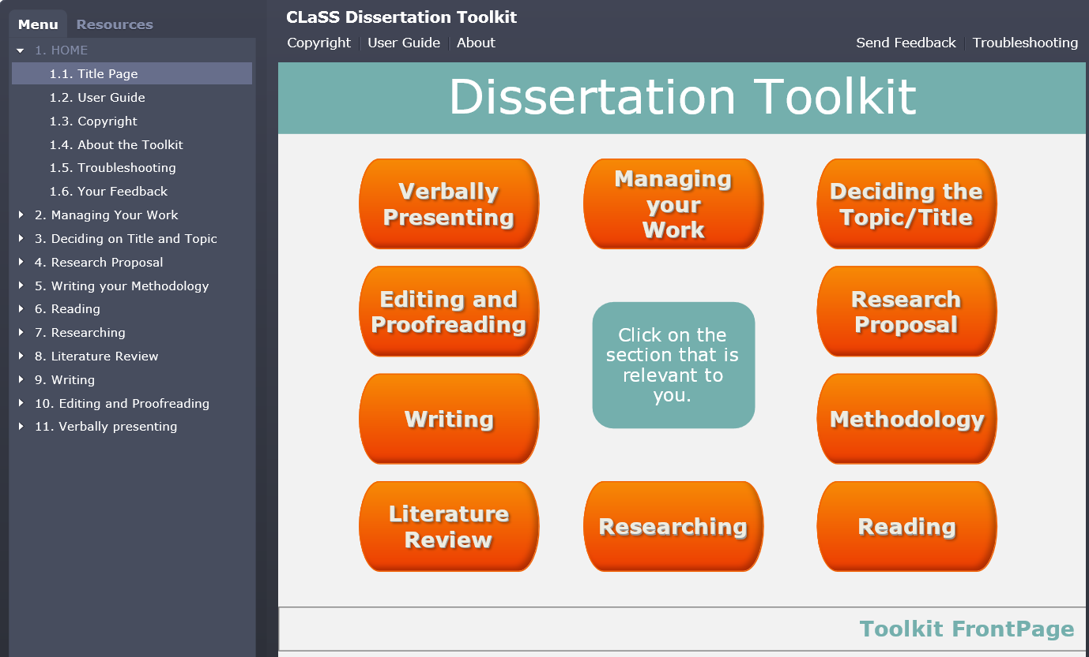
Support Dissertation Toolkit
https://library.dmu.ac.uk/class/disstoolkit

Slide 28
In this session we have looked at...
What is a literature review?
Drawing out themes
Structuring a literature review
Synthesising sources

Slide 29
Questions ?

